Slide 1
Business Context
Essential business requirements
Projects are launched when the value of solving recognized problems exceeds the cost of doing so
create software – not just because
  solve specific problem (even hobby projects - nginx)
should cost less (not only money)
requirements & architecture affect the cost => need the context
Yes, Software Engineering requires Business awareness as well!!

Slide 2
Understand Business Context
Minimally:
  Understand the application domain
      what kind of business?
        McDonald’s – fast food or franchising?
      e.g., healthcare? HIPAA is assumed
      e.g., e-commerce? Conversion rate & payment integrations – critical
      spend time on
        domain investigation - understand
        terminology – understand & communications
        regulations – no surprises
  Identify stakeholders
      Missing stakeholder – (potentially) massive rework
        We built a system & legal dep blocked everything
      Will cover later

Slide 3
Understand Business Context
Minimally:
  Project priorities
        Drivers: significant success objectives;
          e.g., profit margin
            => system cost – primary concern
        Constraints: limiting factors
          e.g., launch before Christmas
            competitors, date-specific products
            => non-negotiable => architecture should accommodate
            => better architecture, but after Xmas? No
        Degree of freedom: factors that can balance constraints and drivers;
          trade-off space (sacrifices)
          e.g., time constraints => buy a service => cost is up
          e.g., need iOS app => native or cross-platform – doesn’t matter

Slide 4
Understand Business Context
Minimally:
  Operating environment
        How the system will be used - user environment
          e.g., call-center support in noisy offices
            => UI must minimize data entry errors
          e.g., doctors with tablets visit patients
            system design decisions?
            => touch interfaces
            => offline work
            => synchronization
        Hardware & infra context - deployment environment
          e.g., on-premise in secure intranet
            => no external API calls => cannot rely on external functionality
          e.g., AWS deployment
          => high availability are easier to achieve => design is affected

Slide 5
Business Drivers
Market share, competition
  gain / protect market share
  e.g., all competitors have this
  e.g., we need to have it first
  need to do fast
Product lines
  missing products
  e.g., we have all majors but puppet arts (University of Connecticut)
  need to integrate into current ones
Global markets
  localization (languages, laws, etc)
  need to reshape some arch aspects
Revenue
  need to minimize costs OR introduce smt new (subscription model)
[Market Requirements Document]

Slide 6
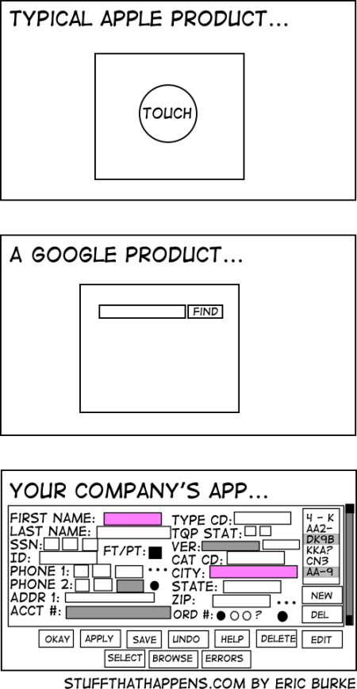
Business Drivers
Cost to develop, deploy, operate, and maintain
  need to minimize costs
Personnel objectives
  e.g., increase staff effectiveness
  e.g., decrease onboarding time
  need to improve usability & simplicity (internal systems)
Liability, safety, reputation
  need a bullet-proof solution
Standards and regulations
Intellectual property
Environmental and sustainability concerns

Slide 7





Stakeholders
What is a Stakeholder? Not just PO / client
  any individual or organization which is
    actively involved in
    materially affected by
    or influences
    the outcome of the system
Hospital appointment system:
  Patients?
    use the system
  Nurses & doctors?
    their workflow depend on it
  Development team?
    will affect the system
  Cleaning staff?
    not affected in any way
  Data protection officer
    Can stop the project if data is not handled correctly

Slide 8
Stakeholders
360 degrees of
perspective
Business Problem
primary concern map
Customers
Managers
Users
Analysts
Investors
Deployment
Development
Technical Writers
Developers
Service Providers
Testers
Maintainers
Conflicting interests:
Patients – same-day booking
Doctors – predictable schedule
Technical Solution
What is a ‘business’ stakeholder?

Slide 9
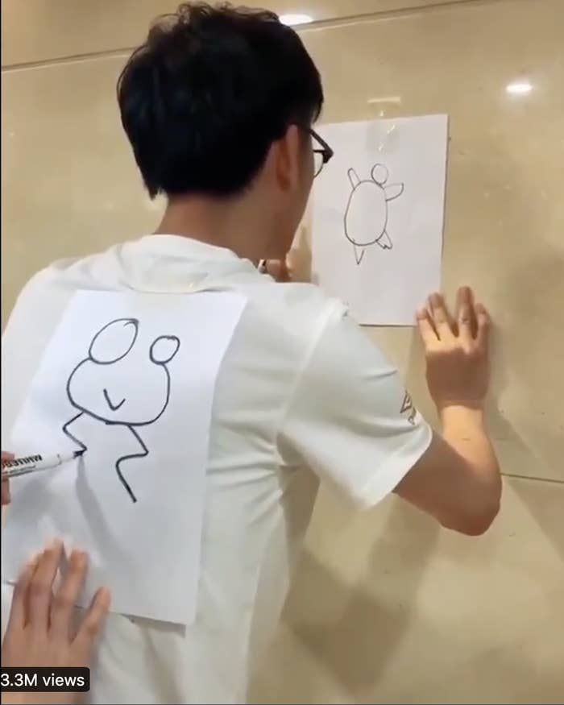
Formulate a Vision, Understand Scope
Before architecturing
  full understanding & alignment
    stakeholders agreed WHAT problem should be addressed
  or else
    project drifts
    system solves a different problem
  e.g.,
    built: bank app with gamification
    customers wanted: fast balance check
    wasted: millions of $$$
    why: ignored customers’ interests

Slide 10
Formulate a Vision, Understand Scope
Solution – Vision & Scope document
Gain understanding and agreement with the stakeholders on …
  Problem – the business opportunity or problem to be addressed
    Good: online orders fail during peak hours, causing revenue loss
    Bad: our monolith is not scalable => orders lost in peak hours => money loss
    why bad one is bad?
  Purpose – how the system will solve the problem in general
    e.g., ensure reliable online ordering [by improving scalability & fault tolerance] (passable)
    no tech details
  Vision – long-term strategic purpose and intent of the system
    Good: provide excellent shopping experience across all devices, becoming #1 service
    Bad: in sprint 1, we…
    guidance for architects – systems live long
      1 temporary page => largest project 3 years later

Slide 11
Formulate a Vision, Understand Scope
Solution – Vision & Scope document
Gain understanding and agreement with the stakeholders on …
  Scope – long-term vision’s part to be addressed now
    Vision: excellent shopping experience across all devices, becoming #1 service
    Scope:
      mobile app for the US only
      payment integrations
      real-time inventory
    what to build & what NOT to build
    avoid scope creep
  System Boundary (scope) – the boundaries of the problem and solution
    Inside: driver app, rider app, matching algorithms
    Outside: payment gateway (integrated), Google Maps (integrated)
    Can we build a payment gateway? No!

Slide 12
Formulate a Vision, Understand Scope
Example:
  Problem: Long patient wait times due to manual check-in.
  Purpose: Automate check-in via mobile.
  Vision: Digital-first patient experience reducing wait times by 50%.
  Scope: Support appointment booking and check-in, pilot in one hospital branch.
  Boundary: Payment and insurance processing handled by existing systems, not in scope.
  Reference point for every architectural decision.

Slide 13
Problem Statement
Characterize the business opportunity / problem
With the stakeholders (consensus!), formulate a problem statement:
  The problem of <describe the problem>
    no solutions / tech details
    business focused
    example keywords: lack of, inconsistency in, delay in, difficulty with, inability to, etc
  Affects <the stakeholders affected by the problem>
    do not skip
  The impact of which is <what is the impact of the problem>
    negative consequences
    why it matters (very briefly)
  A successful solution would <list some key benefits of a successful solution>
    what success looks like
    don’t specify tech details!

Slide 14
Example Problem Statement
The problem of: customer service is bad
  Is it good or bad problem definition? Why?
    Bad: customer service is bad – what is bad?
    Good: untimely and improper resolution of customer service issues
      Addressed specifics
Affects: our customers, customer support reps and service technicians.
The impact of which is: customer dissatisfaction, perceived lack of quality, unhappy employees and loss of revenue.
A successful solution would:
  provide real-time AI-powered access to a knowledge base for support reps
  facilitate dispatch of service technicians, in a timely manner only to those locations which genuinely need their assistance
    some can be resolved by support reps

Slide 15
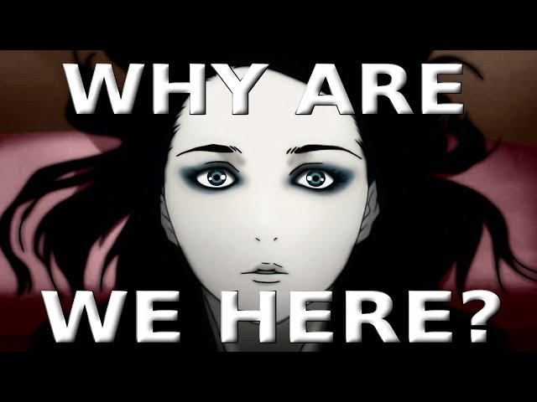
System Purpose
  Why THIS project is needed
    how it’s going to address the problem
    not technology, the essence
Essence - fundamental purpose of the system to exists - raison d'être
  should tie to the original problem statement!
  all requirements must serve this purpose – define a purpose well
Problem: bank clients cannot withdraw money when the office is closed
Purpose (ATM): let clients withdraw money at any time
  Essence: withdraw money from a bank account
  Implementation: cards, PINs, buttons, etc.
  Lots of technological solutions, but only one essence / essential goal
  e.g., replace cards by biometrics
    different feature
    same essence

Slide 16
System Purpose
  Problem: patients need to check-in manually
  Purpose: self check-in via a mobile app
  Implemented:
    chat
    health articles
    appointment calendar
    insurance card storage
    parking payments
  Did it serve the purpose?
    bad purpose or wasted money

Slide 17
Purpose, Advantage, Measurement
Purpose: what the system will do
  not enough
  justify why resources should be spent
Advantage: what business advantage does it provide?
  e.g., ATM:
    need less tellers => lower salary expenses
    expended service hours => customers are happy => loyalty
    customer convenience => loyalty
    still not enough – need to measure
Measurement: how do you measure the advantage?
  40% less in-person withdrawals => fire 40% of tellers
  customer happiness up by 13% => 7% less switch to other banks
[Robertson and Robertson]

Slide 18
Purpose, Advantage, Measurement
Why?
  you are C-level management
  smb tells you
    I have a genius idea! Will save $1kk per year!
  need to understand the profit & expenses & feasibility
Cost-benefit analysis!
  Reasonable? Is cost < advantage (value)?
    new portal costs $20kk, but saves only $1kk / year
  Feasible? Is the target realistic?
    patient wait time from 40 minutes to 5 minutes? Really?..
  Achievable? Can the company create & maintain the system?
    small startup building a cloud datacenter?..
Is the project practical?
[Robertson and Robertson]

Slide 19
Purpose, Advantage, Measurement (PAM) Example
Winter Road Maintenance system
  Purpose: accurate forecasting road freezing times & dispatching de-icing trucks
  Advantage: reduce road accidents by forecasting icy road conditions
  Measurement: ice-caused accidents < 15% of accidents
Additional purpose
  Purpose: save money on winter road maintenance costs
  Advantage: reduced unnecessary de-icing
  Measurement: de-icing cost to be reduced by 25%
  You can approve or reject, what do you do? Why?
[Robertson and Robertson]

Slide 20
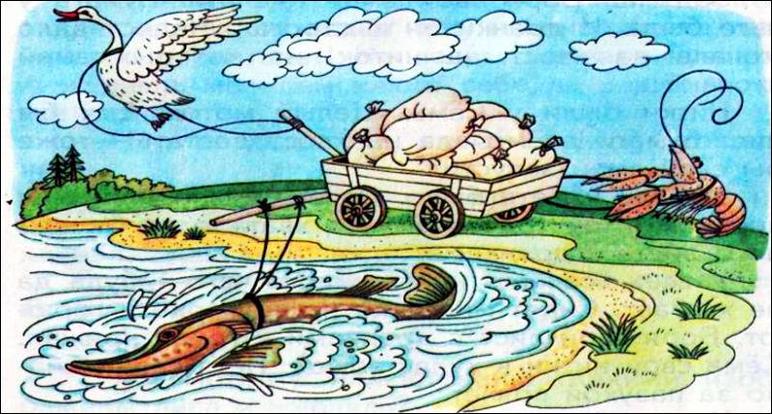
Vision Statement of the Solution
1 project
  3 teams, 3 project understanding
    Team 1 – save money
    Team 2 – customer convenience
    Team 3 – collect data
  Chaos
    different features
    same features are different
Strategic vision for how the system will achieve business objectives
  Decision making context during the system’s life cycle
  e.g., Kindle - “every book, ever printed, in any language, available in under 60 seconds.”
  e.g., vision emphasizes speed, won’t prioritize a feature that slows down UX.

Slide 21
Vision Statement of the Solution
Template for a consensus among stakeholders
  For <customer> - primary beneficiary
    voters
  Who <problem statement(s)> - main pain points of beneficiaries
    need to vote electronically to comply with current election laws
  The <system name > - so we can reference it
    RIT Voting Kiosk
  Is <system category> - brief idea what it is
    an electronic voting machine
  That <key benefits> - core advantage
    will comply with all election laws, provide an easy-to-use interface, and be fully secure
  Unlike <existing or alternative solutions> - what are the current options
    previous voting machines in the market
  Our system <is an x that provides y> - how is it different
    will redundantly record every vote on paper to enable recounts and prevent fraud

Slide 22
Cautions
Functional requirements are from
  problem
  vision statement
Implied requirements
  often missed
  e.g.,
    security
    quality
    scalability
“I didn’t write it down, but it’s obvious, isn’t it?”
  no, it’s not
  “WRITE IT DOWN”!
Functional requirements
  withdraw money
  check account balance
  deposit money
Implied (NF) requirements
  examples?
  ATM must encrypt PIN
  multi-language support
  availability > 99% per day
  95% transactions < 5 seconds
Skip functional – devs will ask
Skip NF – devs will ignore

Slide 23
Example System Vision Statement
(Voting Machine)
For voters who need to vote electronically to comply with current election laws the RIT Voting Kiosk is an electronic voting machine that will comply with all election laws, provide an easy to use interface, and be fully secure. It will be highly reliable and easy to configure for new elections. Unlike previous voting machines in the market our system will redundantly record every vote on paper to enable recounts and prevent fraud.

Slide 24
System Scope Analysis
Scope – part of the long-term vision to be built right now
  e.g.
    Vision – become a world-class scientist & discover immortality
    Scope – graduate with a bachelor’s degree
    current project
      not the first step of the project
Not defined by business alone
  dev team provides a reality check
  discussion
  balance between ambition (vision) and reality (resources)
  e.g.,
    Business: real-time interplanetary video calls!
    Tech:
      cannot do, physics, speed of light
      let’s record and send video messages

Slide 25
System Scope Analysis
Project release plan - initial and subsequent release features
  roadmap (in a way):
    MVP – list of features
    next release – list of features
    next release – list of features
    (ideally) with approximate dates / quoters / years
    almost never goes perfectly
      still better to have
      adjust along the road
    senior project & 4 hours meeting
    e.g.,
      Release 1 - balance inquiry, cash withdrawal, PIN authentication
      Release 2 - fund transfer, bill payment, SMS alerts
      Release 3 - personal finance insights, AI credit scoring

Slide 26
System Scope Analysis
Project release plan - initial and subsequent release features
  nice to have (very nice) – brings clarity
    What drivers and constraints?
      Drivers – what pushes us forward
        e.g., market demand, regulations (Chinese insurance regulations)
      Constraints – what’s holding us back
        e.g., budget, expertise, tech debt
    System product line strategy?
      only one product VS part of a product line
      different system design
        mobile telecom VS mobile + landline + internet + public wi-fi + starlink
    System platform opportunities?
      short versus long term investment
      will we stop or extend later?
      different design decisions

Slide 27
Determine System Boundaries

Slide 28
System Thinking
What is the system?
  All of the inputs – data, events, etc
    e.g., customer order & payment info
  All of the outputs – data, events, reports, etc
    e.g., delivered food & receipt
  All of the logic that translates inputs into outputs
What is system thinking?
  Thinking strategically to visualize the holistic system solution
  Seeing the big picture
  Seeing how decisions will affect the system
  Keep the system simple and management while maintaining completeness
System analyst/architect role/responsibility

Slide 29
System Thinking
Add a payment button
  what to think about?
    payment security
    refunds
    accounting integration
    user flows
    etc

Slide 30
System Thinking (cont)
Why is system thinking important?
  avoid missing requirements
    need to see the whole system
    e.g., designed ATM, forgot cash refill
  stimulates innovative solutions thinking
    need to see the whole system
    reconstruct the system
  extensible system architecture
    scale without redesign
    need to see the future system
  scales and structures project scope planning
    break down into pieces
    need to understand dependencies
  add value to the user and businesses
    the whole is greater than the sum of the parts
    e.g., everything is cross-integrated, no duplications in data

Slide 31
Establish the System Boundaries
Scope and scale
  What the system is
  What the system is not
    write down to avoid implications
    food delivery – not fraud detection
  Draw a circle around the problem
Constraints
  Environment – healthcare -> HIPAA
  Budget - $50k for MVP, GPU-cluster is out
  Schedule – Xmas or never
  Technology – php-hosting
  Politics – have to please a stakeholder
  Legacy systems to integrate or replace
If not:
  scope creep
  blame games
  budget overrun
  schedule overrun
Don’t boil the ocean!
FBI Virtual Case File
from “case tracking system”
to “everything”
massive budget overrun
cancelled

Slide 32
Establish the System Boundaries
System boundary?
Is voice mail an actor or part of the system?
Which boundary? Why?
What is a trade-off?
voice mail included
  higher cost
  longer schedule
  more testing
voice main excluded
  simpler
  faster delivery
  less control
responsibility vs dependency
  & time & budget & etc
Voice Mail
Caller
(actor)
Simple Phone
System
Callee
(actor)

Slide 33
System Boundary?
Actors interact with the system
  NOT a part of the system
  Can be
    human
    device (e.g., printer)
    another system (e.g., Mastercard)
Software and hardware infrastructure are NOT actors
  part of the system
  we are responsible
  e.g., database server
iDevice
iTunes

Slide 34
The Context Diagram
Graphical representation of the system
  understandable for stakeholders
    many are non-technical
  map of the system
    what’s inside
    what’s outside
    how they interact
Establishes the system boundaries and connections
Simple graphical conventions:
  Central circle - abstraction of the entire system – the boundary
  Rectangles - terminators outside of the system - people, other systems, organizations, devices
  Arrows - input and output flows of data, control, material

Slide 35
System Scope Representation
Context Diagram Example
Salesperson
Financial
System
Operator Actions
Operator
Responses
Payment Request
Payment Approval
Inventory
Record
Consumer Purchases
Consumer
Management
System
Inventory
System
Point of Sale
System
Marketing Collateral
Scanned Item Record
Receipt Record
Scanned Card Record
Scanner
Card Reader
Printer

Slide 36
Business Proposal Documents
You have an idea
  connect restaurants to local food banks
    save food waste
    get restaurants more money
    help food banks
  how do you get money / resources?
    investor
    inside of your company
    have to communicate the idea

Slide 37
Business Proposal Documents
You have an idea
  audience
    outside investors
    in-company project competition
      board members
        does it fit the company mission?
        long-term impact and risks
      leadership
        does it fit the strategy?
      project review committee
        does it fit the budget?
    non-technical
    not a lot of time

Slide 38
Business Proposal Documents
What:
  what it does
  clear, but brief
  purpose, not feature list
Who:
  use – restaurants & food banks
  buy - non-profit food banks
  promote – sustainability groups
  competitors – app 1, app 2,..
  non-direct competitors – e.g., for who for Netflix?
    computer games - attention
Why:
  financially – revenue
  strategically – brand reputation

Slide 39
Key factors
Details, but not too much detail
  Bad: 50-page appendix on algorithms for a mobile app
  Good: app uses an AI-based recommendation engine tested on 1,000 users with a 20% engagement boost
  Danger: too brief || vague
Focus is on ‘what’, not ‘how’
  Bad: k8s cluster with Docker containers scaling via auto-healing nodes…
  Good: system scales automatically to handle thousands of users without downtime
  MBA, not PhD in CS
  value, not ways to achieve it

Slide 40
Key factors
Enough ‘how’, just not too much
  give an approach idea
  important technical factors – differentiate from competitors
  Bad: we will improve the metric by 100%! How?..
  Bad: [a lot of tech details]
  Good: patented thin-film material that reduces production costs by 25%
Groundbreaking idea / invention?
  emphasize it! – key differentiator
Controversial approach?
  hiding won’t end well
  highlight upfront
  explain why

Slide 41
Informal
Elevator Pitch
  “If you run into an influencer / CEO / investor in an elevator, what would you say during the ride up”
  don’t typically meet them
  30-60 seconds
  How to spark their interest?
Brief
  Headline, not an article
Hits highlights
  1 or 2 strongest points
Conveys concepts and value
Generates interest for a follow up
  goal – not to close the deal
  goal – not to share information
  goal – “tell me more” / “call me” / “let’s meet”

Slide 42
Informal
strongest points
concept & value
Spotify gives you access to millions of songs on demand. You can stream any music you want, anytime, build playlists, and discover new artists effortlessly.
  revolution
DreamSync records your dreams and transforms them into animations by morning. Instead of forgetting your wildest ideas, you wake up with a personalized journal that can inspire your next book.
Give one for Uber.
Uber puts a personal driver in your pocket. With just a tap, you can get a ride anytime, anywhere, cheaper than a taxi and paid automatically through the app.

Slide 43
Business Context -> Requirements
One of the most important activities in Software design
  taking (high level) business goals and extracting requirements
  Fail =>
    works
    doesn’t bring value
Business goals
  High level – reduce patient wait time
Requirements
  Actionable - automatically assign earliest available appointment

Slide 44
Business Context -> Requirements
You need
- ASRs – shape the architecture
  must support multiple hospital branches
  must support 5k concurrent users
- Constraints
  must comply with HIPAA
- Design – influences usability
  must be mobile-friendly
- Functional requirements – what the system does
- Non-Functional requirements – qualities of the system
  appointment search results in < 2s
- Measurement criteria – how do we know the goal is met
  reduce average wait time by 30%

Slide 45
How to get there?
Business Proposal
Interviews/ Questionnaires/ Research
ASRs
Constraints
Input
Process
Success Factors
Outputs
Discussion is critical! Patiently extract the necessary level of technical details needed, and document them!

Slide 46
Extracting the requirements
Also known as ‘elicitation’
Techniques
- Document analysis
  Review & analyze
    Policies
    Manuals
    Reports
    Logs
  Understanding how it functions
    Cannot change processes
  Especially for regulated domains
    This specific organization deals with them
  Insights, e.g.
    Analyze hospital records
    See appointment no-show rate

Slide 47
Extracting the requirements
Techniques
- Interviews
  Rules vs reality
  Stakeholders
  Construct questions in advance
  Follow the script
  Record answers (ideally a dedicated person)
  Follow-up questions
  Summarize & validate
    Avoid misunderstandings
    Not immediately

Slide 48
Extracting the requirements
Techniques
- Research
  Check
    Market practices
    Industry standards
    Competitors
    e.g.,
      What is “must-have”
- Surveys
  Gather opinions from users
  e.g.,
    Survey 500 patients – sms VS email VS phone reminders

Slide 49
Extracting the requirements
Techniques
- Focus Groups
  Survey / discuss with small focus groups
  e.g.,
    nurses want manageable hours
    patients want certainty in the schedule
    doctors want flexibility
  can highlight conflicting needs

Slide 50
References
Karl Wiegers, Software Requirements, 3rd Edition, Microsoft Press, 2003 (Chapter 5)
Suzanne Robertson and James Robertson, Mastering the Requirements Process, Addison-Wesley, 1999
Rational Unified Process, IBM

